Slide 1
Disability income claim intervention
- who are the selected few, and - the impact on their return to work
Landi du Toit, University of Cape Town
May 11th – May 15th 2020

Slide 2
About the speaker
Landi du toit
Senior lecturer UCT Actuarial Science
Qualified Actuary, worked in Reinsurance, Bio Stats
Passion for using analytical skills to improve lives
University of Cape Town (UCT)
Multicultural, multinational community with some 29 000 students from over 100 countries across the globe
Currently the top-rated university in Africa and one of the top-rated universities in the world

Slide 3
Outline
1. Background
Disability insurance in SA
Claim intervention
2. Data &
3. Methodology
4. Results
Exploratory
Intervened subgroup
Claim factors significant to RTW
5.Conclusions

Slide 4
1. Background disability insurance in South Africa
A need for optimally managed DI claims by life insurance companies in SA.
Does claim intervention significantly impact RTW terminations of group DI claimants?
Schriek and Lewis (2010) found that the strongest correlations with increased DI claims incidence were with consumer confidence and unemployment.
The political and economic uncertainty in addition to the potential impact on claim terminations due to the 2015 change in DI tax treatment..
Recent South African experience showed an increase in group risk claim payments year on year of more than 32 per cent (year ending June 2016 to June 2017 (TrueSouth, 2017)).
Notes:
Group insurance has seen tremendous growth and success in the SA market, major reason the lack of funding from the state³
Schriek, K. and Lewis, P. (2010). The Link Between Disability Experience and Economic Conditions in South Africa. Paper presented at the International Congress of Actuaries 2010. Cape Town, South Africa
True South. (2015). Assessing the effieciency of the South African insurance market in its provison of disablity cover: An update to the 2013 study. Johannesburg: True South Actuaries and Consultants
True South (2017)

Slide 5
1. Background Claim intervention
The results of a Swiss Re survey of nine Australian life insurance companies, reported that life insurers saved between 24 and 39 Australian Dollars for every one Australian Dollar spent on rehabilitation of DI claimants (Van Den Akker, 2014).

Slide 6
1. Background Claim intervention
Significant losses on SA group DI business in early 1990s resulted in a more active approach needed in managing disability income claims (Byrne. 2001)
This was the first time occupational therapists and other medical experts were hired as part of insurers’ claims management teams, viewed as more of an administrative role up to this point (Byrne, 2001)
Active claims management included the rehabilitation of claimants to return to work
SA challenges:
Lack of holistic approach?
Lack of funding?
Notes:
4. Lewis, P.L., Cooper-Williams, J., Rossouw, L (2005). Current Issues in South African Group Life Insurance, South African Actuarial Convention 2005

Slide 7
1. Background Claim Intervention
Mental health;
Musculoskeletal; and
Circulatory issues
consistently included in literature as predominant causes of disability experienced or anticipated.
Successful claim intervention is not likely to be a one-size-fits-all approach.

Slide 8
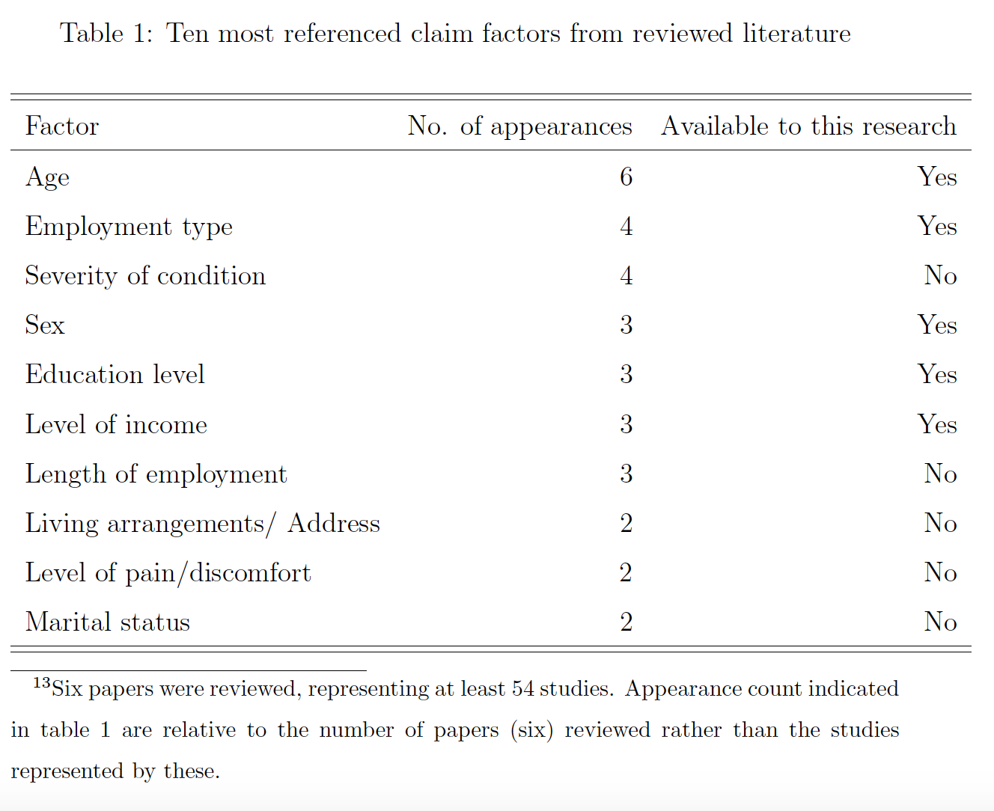
1. Background Claim factors significant to RTW
The presence of both medical and contextual factors in the prediction of RTW was one of the major conclusions found by Hankins (2013).

Slide 9
2. Data
Group, permanent, disability income claims of large South African life insurance company.
Data included a large number of claim factors of claims that incurred over a 20 year period (between January 1997 and November 2016).
Claims included those that have terminated as well as claims which were still in payment at the date of data extraction.
Claims terminated at the earlier of death; reaching a specified NRA; or returning to work.
A total of 12,976 unique claims were retained.

Slide 10
2. Data Claim factors
Claim characteristics
1. Claim intervention
2. Date of disability
3. Claim duration
4. Cause of disability
Demographic
5. Age
6. Sex
7. Education level
Occupation-related
8. Salary
9. Occupation field
10. Occupation level
11. Occupation strength rating
Policy characteristics
12. Benefit amount
13. Replacement ratio
The selection of claim factors was done by considering
Literature on claim factors significantly correlated to RTW;
Taking into account data completeness
Researcher judgement regarding potential usefulness to explain RTW

Slide 11
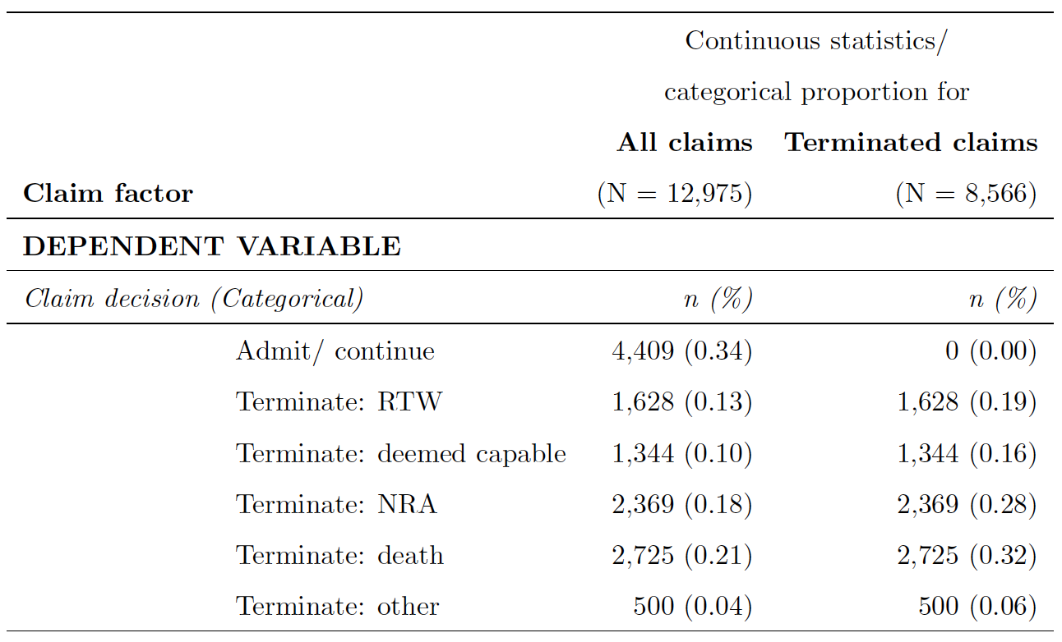
2. Data Claim outcome
A RTW-indicator variable was created:
1 : “RTW" and “Deemed capable to RTW”
0 : All other outcomes

Slide 12
2. Data Claim intervention
Phone interventions
follow up on adequate treatment, etc.;
Return to work facilitation
outsourced in the past;
Actual rehabilitation
life insurer paying for treatment, that can be anything from a dietician to physiotherapy;
Case management
might include an outsourced case manager that acts on behalf of the life insurer (adaptations in the workplace, etc.) as well as work preparedness programs; and
Forensics
to rule out fraud, this might include monthly checks on spending, checks for change in employer, comprehensive background checks on individuals.
This included claimants who were indicated as having received some form of intervention initiated by the insurer, including but not limited to:

Slide 13
2. Data Claim intervention
This included claimants who were indicated as having received some form of intervention initiated by the insurer, including but not limited to:

Slide 14
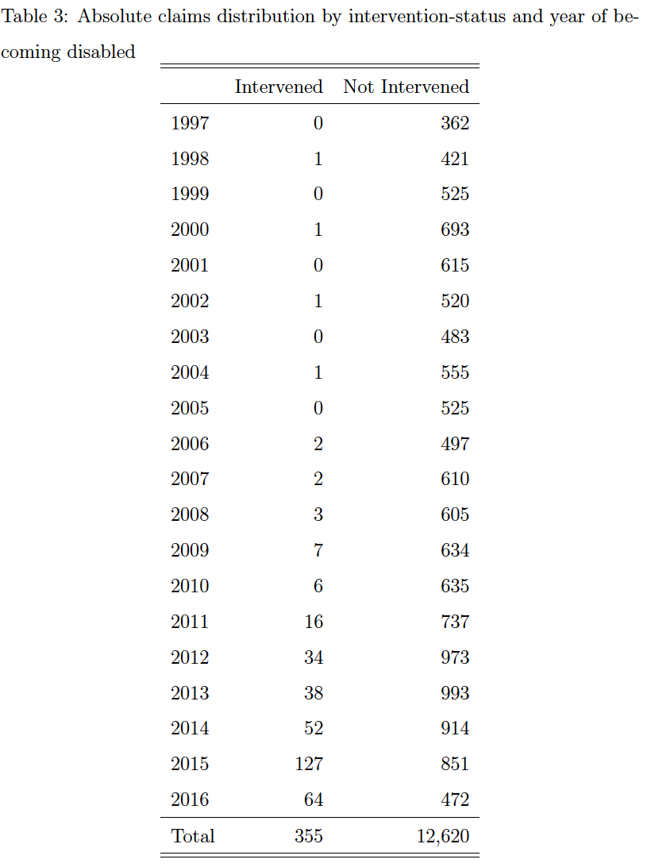
2. Data limitations
Important clinical data not provided
in particular type (and intensity) of intervention per claimant.
Significant factors not available
Some factors identified through literature as significant to RTW were not available, in particular claim severity and claim definition per claimant.
Incomplete data fields
Of factors that might be significant to RTW, for example sparsely populated area of residence, insufficient to include in the analysis due to the low volume and seemingly arbitrary completeness.
Low volume of intervened claimants
Intervened claims distribution
accumulated around the last two years of exposure.
Lack of claims run-off experience
at longer durations for intervened claims.
Right-censored data (incomplete run-off)
impacting intervened claims to a much larger extent than non-intervened.
Selection-effect on intervened claims
not fully explainable from observed claim factors due to the lack of certain claim information detail.

Slide 15
3. Methodology
Exploratory analysis
Each claim factor was considered in turn to identify potential RTW significance
Include graphs, tables and univariate logistic regression
Variable correlations and associations
Pairwise and VIF tests to reduce multicollinearity.
Multivariate regression
To identify most parsimonious model, thus optimal RTW claim factors
Claims run-off estimation
Cox-proportional hazards model; as well as a high-level ultimate run-off estimate
Intervened subgroup critical analysis
The composition of the intervention subgroup was analysed in the context of the claim factors that were identified as significantly related to RTW.

Slide 16
3. Methodology
Exploratory analysis
Each claim factor was considered in turn to identify potential RTW significance
Include graphs, tables and univariate logistic regression
Variable correlations and associations
Pairwise and VIF tests to reduce multicollinearity.
Multivariate regression
To identify most parsimonious model, thus optimal RTW claim factors
Claims run-off estimation
Cox-proportional hazards model; as well as a high-level ultimate run-off estimate
Intervened subgroup critical analysis
The composition of the intervention subgroup was analysed in the context of the claim factors that were identified as significantly related to RTW.

Slide 17
3. Methodology Multivariate regression
A full model was constructed, including all claim factors identified in the exploratory analyses as potentially significantly related to RTW.
Multicollinearity was tested for and the affected variables were removed, resulting in a nested model (full model excluding variables with potential high linear associations).
Stepwise regression was applied to the nested model to identify the model with the least number of variables without compromising on model fit.
The resulting model was further manually adjusted to improve parsimony without compromising fit, by taking into account statistical significance as well as practical significance, i.e. quantitative impact of remaining variables.
The process resulted in 7-variable optimal models for both data sets.
Claim factors
10 Multivariate
7 Optimal
13 Exploratory

Slide 18
Exploratory 13
Claim characteristics (C)
Multivariate 10
Optimal 7
Claim characteristics (C)
Claim intervention
Date of disability
Claim duration
Cause of disability
Demographic (D)
Age
Sex
Education level
Occupation-related (O)
Salary
Occupation field
Occupation level
Occupation strength rating
Policy characteristics (P)
Benefit amount
Replacement ratio
Claim characteristics (C)
Claim intervention
Date of disability
Claim duration
Cause of disability
Demographic (D)
Age
Sex
Education level
Occupation-related (O)
Salary
Occupation field
Occupation level
Occupation strength rating
Policy characteristics (P)
Benefit amount
Replacement ratio
Claim intervention
Cause of disability
Demographic (D)
Age
Sex
Education level
Occupation-related (O)
Policy characteristics (P)
Benefit amount
Replacement ratio
Claim duration
Date of disability
Occupation level
Salary
Occupation field
Occupation strength rating

Slide 19
3. Methodology Intervened subgroup critical analysis
analysed the composition of the intervened claims group by each of claim factors that were identified as significantly related to RTW (in addition to intervention) in the multiple regression;
identified interactions between intervention and other claim factors, by adding interaction effects to the optimal multiple regression models; and
quantified impact by fitting the optimal multiple regression models to the intervened population.

Slide 20
4. Results
Age at date of disability (D)
Sex of claimant (D)
Education level (D)
Occupation level (O)
Replacement ratio (P)
Cause of disability (C)
Claim intervention (C)
Exploratory
Intervened

Slide 21
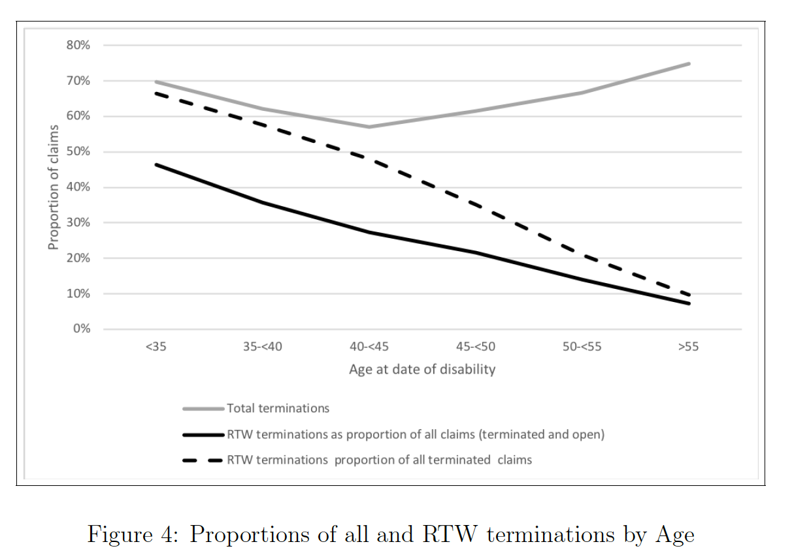
4. Results (EXP) Age
A univariate logistic regression model confirmed a decrease in the probability of RTW as age increases for both all and terminated-only claims, significant at 1%.

Slide 22
4. Results (EXP) sex
It is not intuitively expected that there should be a difference in RTW due to sex of the claimant?

Slide 23
Associations: AGE and Sex
The mean ages observed were 45.34. (females) vs. 47.31 (males)

Slide 24
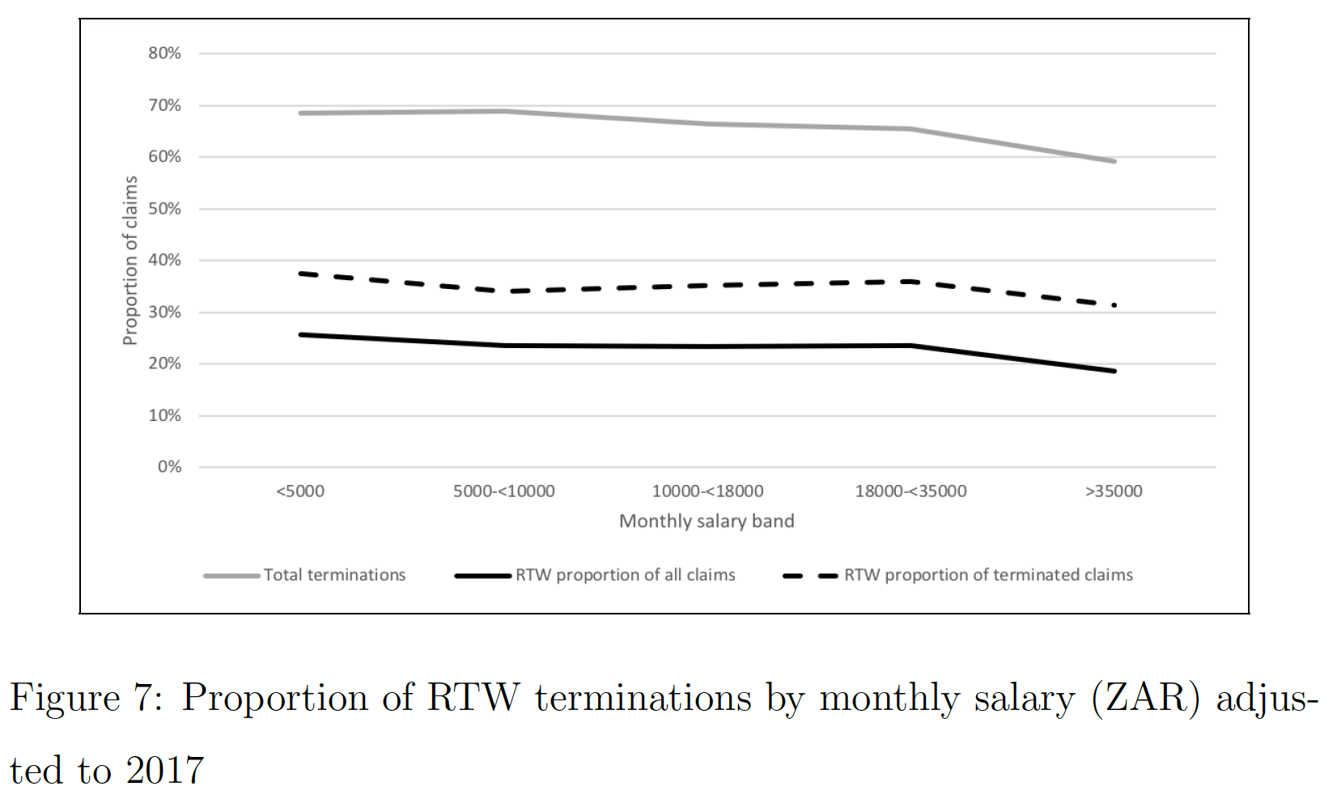
Associations: Age and Salary
Notes:
Interesting to note an apparent decreasing association in RTW as Salary increases. However, the effect of age on Salary needs to be taken into account. (See next slide)

Slide 25
Associations: Age and Salary
Notes:
Strong positive association between increasing salary and increasing age, thus what appears to be a negative association between RTW and Salary likely driven by the underlying increasing age of higher earners. Salary was not retained in the final model as Age, in addition to other factors, showed an optimal fit (sufficient information to explain RTW outcome).

Slide 26
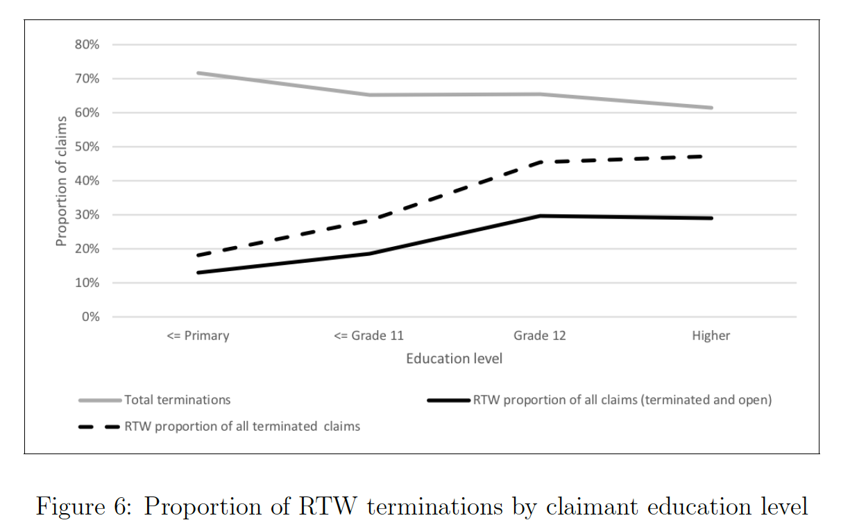
4. Results (exp) Education level
Increased probability of RTW associated with increasing level of education relative to “<= Primary", was significant at the 1% level.

Slide 27
4. Results (EXP) Occupation level
Univariate logistic regression confirmed that claimants at “semi-skilled" occupation level had higher expected RTW probability than claimants at “unskilled" occupation level, significant at 1%.

Slide 28
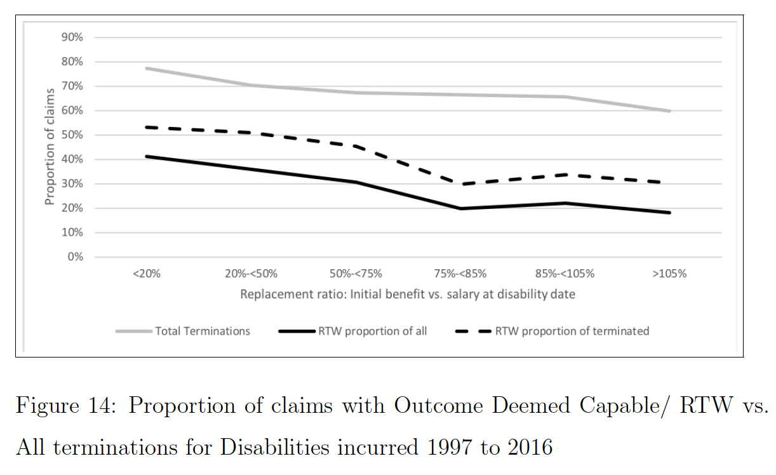
4. Results (EXP) Replacement ratio
The quantitative impact on RTW estimated from coefficients:
RR P(RTW) △P(RTW)
55% 28%
75% 26% ↓ 2%
95% 23% ↓ 3%

Slide 29
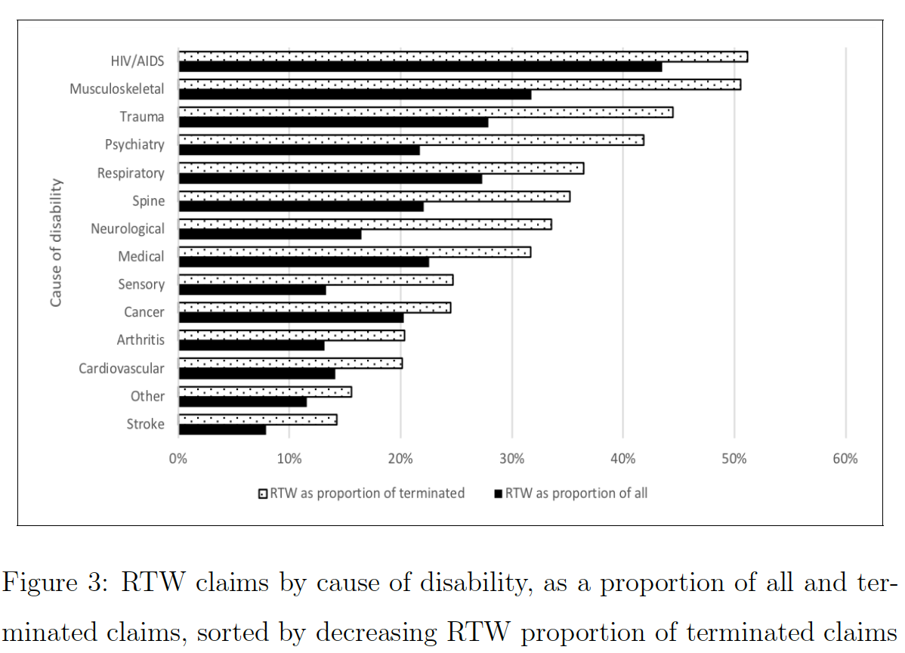
4. Results (EXP) Cause of disability
Analysis per year of becoming disabled revealed changing patterns over time; HIV/AIDS showing particularly high RTW outcomes for disabilities incurred from 2003 onwards.
Notes:
This coincides with an announcement toward the end of 2003 by the South African Department of Health on a comprehensive care, management and treatment programme, after which access to antiretroviral therapy (ART) in South Africa increased dramatically (Johnson, 2012).

Slide 30
4. Results (exp) Claim intervention
RTW of all incurred (open and terminated):
23% of all claims
18% of intervened
Notes:
Driver for this difference the larger proportion of OPEN intervened claims. This will be the final RTW proportions if none of the open claimants RTW, a very pessimistic outcome, especially for the intervened group.

Slide 31
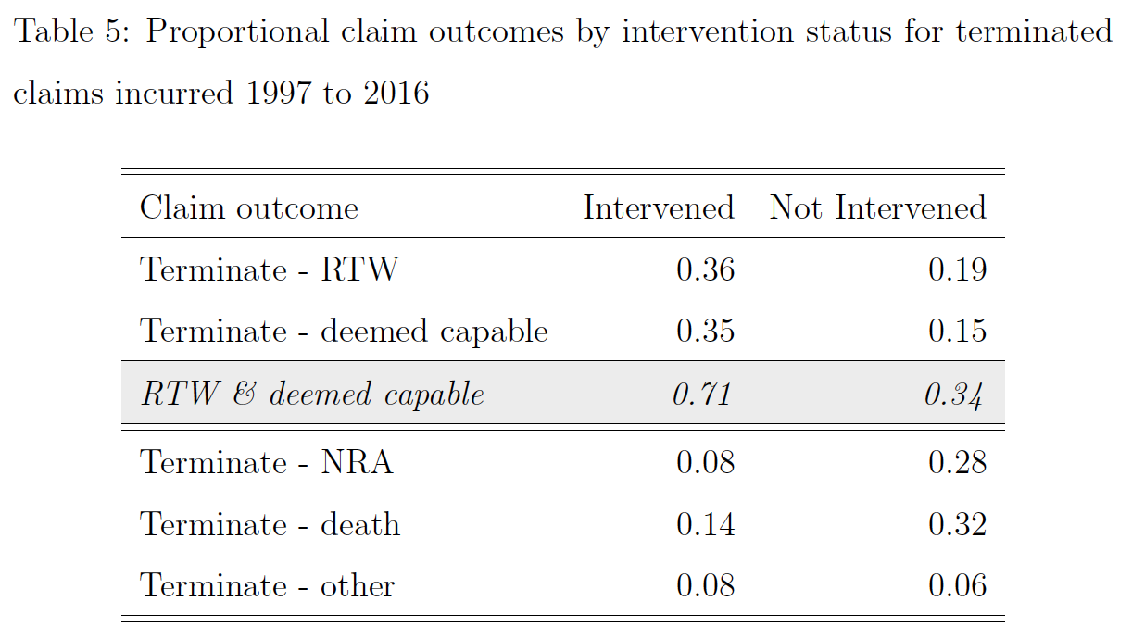
4. Results (EXP) Claim intervention
RTW of all terminated:
34% of all claims
71% of intervened

Slide 32
4. Results Intervened subgroup
Age at date of disability (D)
Sex of claimant (D)
Education level (D)
Occupation level (O)
Replacement ratio (P)
Cause of disability (C)
Claim intervention (C)
Intervened

Slide 33
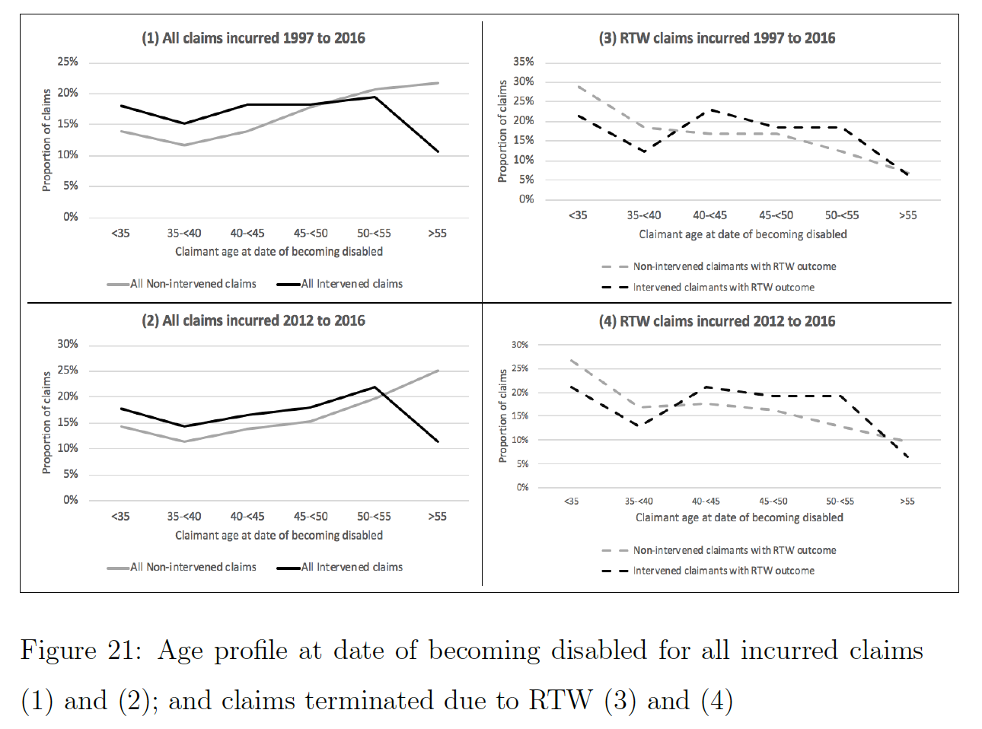
4. Results (INTv) Age

Slide 34
4. Results (INTv) Age
There seemed to be a preference to intervene on younger claimants.
The age distribution of claimants who returned to work, showed that a lower proportion of younger intervened claimants returned to work relative to non-intervened claimants.

Slide 35
4. Results (INTv) Age
Bivariate logistic regression results showed a positive intervention impact on RTW as age at disability increases.
Notes:
A bivariate logistic regression of all claims, with RTW outcome and explanatory variables age at
disability and intervention, testing for the impact of age at disability and intervention independently as well as the interaction of the variables on a RTW outcome.

Slide 36
4. Results (INTv) Sex
Recall that
41% of of female claimant terminations were due to RTW, vs.
33% of male claimants.
A positive impact on RTW due to selection by sex might thus be expected for intervened claims.

Slide 37
4. Results (INTv) Education level
The interaction between intervention and education level was tested for the optimal models of “all" and “terminated-only" claims.
A positive impact on RTW was observed for
“<= Primary" level educated claimants who received intervention relative to other intervened claimants by level of education.
80% vs. 48%
Intervened claimants with Grade 12 or higher education vs. non-intervened claimants.
Notes:
Due to the small absolute number of claimants (seven) with “<= primary” education who received intervention, this result lacks statistical robustness, where 10 is a general minimum number of required observations. This association needs to be tested again once more data is available for this category.
The next smallest category was "<= Grade 11" with 62 intervened claimants.

Slide 38
4. Results (INTv) Occupation level
The only occupation level that showed a statistically significant impact on RTW from both optimal multiple regression models, was a reduction in RTW for “skilled" workers relative to “unskilled".
Notes:
This result does not make intuitive sense, however, might be explained with the availability of more data. For example the lack of per claimant disability definition for this research, where skilled workers might more often be assessed by “own occupation" or “own or suited occupation" definitions vs. unskilled workers, more likely assessed by ability to perform \any occupation".

Slide 39
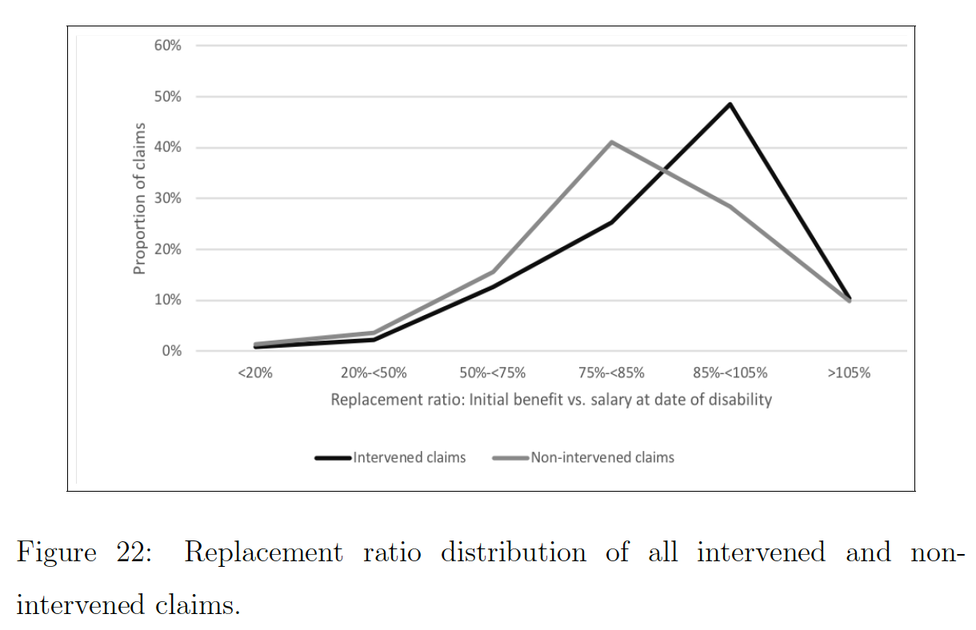
4. Results (INTv) Replacement ratio
Intervention thus positively impacted RTW as replacement ratio increased, relative to increased replacement ratio with no intervention, when considering terminated-only claims.
Intervention impact:
A positive impact on RTW was observed when testing the interaction between replacement ratio and intervention on the “terminated-only” claims optimal model, significant at 5 per cent.

Slide 40
4. Results (INTv) Cause of disability
One of the shortcomings of this research was the lack in availability of severity of disabilities.
Intervened claims distribution by cause of disability, relative to non-intervened claims, had a heavier weighting towards
Psychiatry;
Sensory;
Spine;
Neurological; and
Musculoskeletal claim causes.
Quantifying the impact from the coefficient estimates of the univariate logistic regression model from table 34 above, only resulted in about a 1 percent reduction in RTW explained by distribution by cause.

Slide 41
4. Results (INTv) Cause of disability
Intervention of Cancer and Respiratory claims showed statistically significant improved RTW outcomes.

Slide 42
5. Conclusion Who were Selected and impact on RTW
A 6% higher RTW due to selection is expected for intervened claimants.

Slide 43
5. Conclusion Intervention impact on outcome
Intervention appeared to make a significant positive impact in various pockets of the claims group, these included:
An increasingly improved impact on RTW as age increases for intervened vs. non-intervened claimants;
a positive impact on RTW as replacement ratio increased, relative to increasing replacement with no intervention; and
statistically significant RTW improvement for intervened cancer and respiratory claimants.

Slide 44
5 Conclusion Next steps
Quantity and quality of intervention data to improve understanding true impact.
we need more intervention data (longer durations)
we need more detailed data (intervention and disability)
Quantitative study on niche intervention practice by local reinsurer

Slide 45
Thank you for your attention
Contact details :
Landi Du Toit
Landi.dutoit@uct.ac.za
https://www.actuarialcolloquium2020.com/

Slide 46
Disclaimer:
The views or opinions expressed in this presentation are those of the authors and do not necessarily reflect official policies or positions of the Institut des Actuaires (IA), the International Actuarial Association (IAA) and its Sections.
While every effort has been made to ensure the accuracy and completeness of the material, the IA, IAA and authors give no warranty in that regard and reject any responsibility or liability for any loss or damage incurred through the use of, or reliance upon, the information contained therein. Reproduction and translations are permitted with mention of the source.
Permission is granted to make brief excerpts of the presentation for a published review. Permission is also granted to make limited numbers of copies of items in this presentation for personal, internal, classroom or other instructional use, on condition that the foregoing copyright notice is used so as to give reasonable notice of the author, the IA and the IAA's copyrights. This consent for free limited copying without prior consent of the author, IA or the IAA does not extend to making copies for general distribution, for advertising or promotional purposes, for inclusion in new collective works or for resale.

