Slide 1
An actuary’s view on the Big Data and the data science… an ecosystem of political and socio-economic transition
Octobre 2017

Slide 2
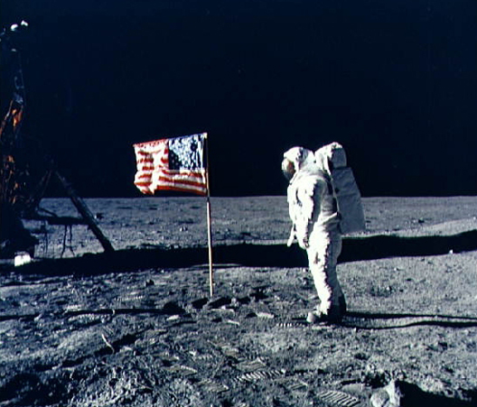
State of the art…
Moving from a world of science fiction to reality ... it's only a matter of time!
Published in 1950
Neil Alden Armstrong, born August 5, 1930 in Wapakoneta, Ohio, USA (and died August 25, 2012 in Cincinnati in the same state, is an American astronaut) is the first man to have set foot on the Moon!
19 years between fiction and reality

Slide 3
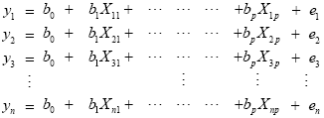
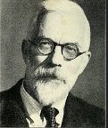
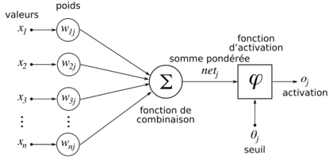
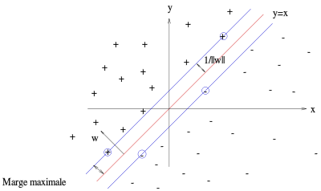
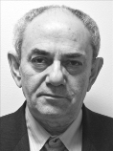
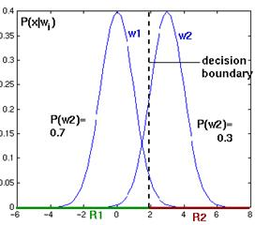
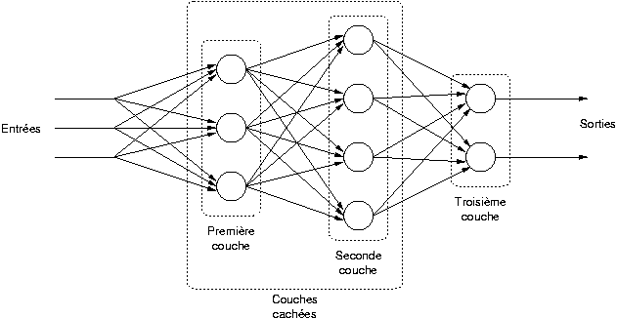
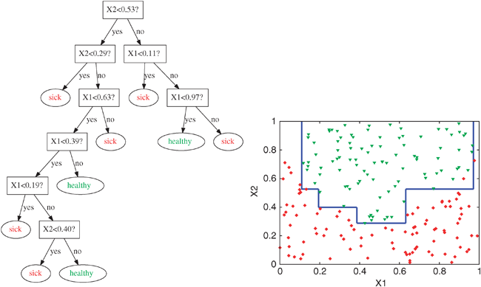
State of the art…
Technical and technological developments of the last hundred years…
10/03/2016:
AlphaGo defeats world champion Go
GLM (Nelder & Wedderburn)
Maximum Likelihood
(R. Fisher)
Perceptron (Rosenblatt)
Theory of statistical learning & SVM (V. Vapnik)
Turing Machine
20
30
40
50
60
70
80
90
00
10
Bayesian Inference
Neural networks
SOME LEARNING ALGORITHMS
Perceptron
Naïve estimator of Bayes
GLM
Arbres de décision
Neural networks
SVM
Boosting, XGBoost…
Boosting
CART (Decision trees)

Slide 4
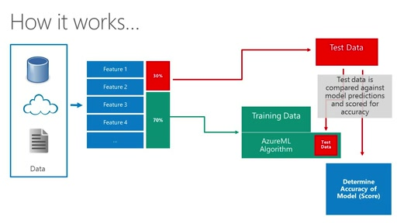
State of the art…
SOURCES / DATA
CRM data
Asset Management
Transactionnal data
Financial market
Past commercial offers
Bloomberg API, National statistics
Etc.
Find the best relationship
USE CASE
Marketing campaign
Fraud detection
Anti-Money laundering
Actuarial loss ratio prediction
New contract propensity
Churn prediction
Sinister prediction
Etc.
Input
Data
Business
Target
Algo 1
Algo 2
Algo n
Big Data
Keywords
Prediction
Regression
Discrimination
Supervised Learning
Unsupervised Learning
Keywords
Typology
Homogeneous classes

Slide 5
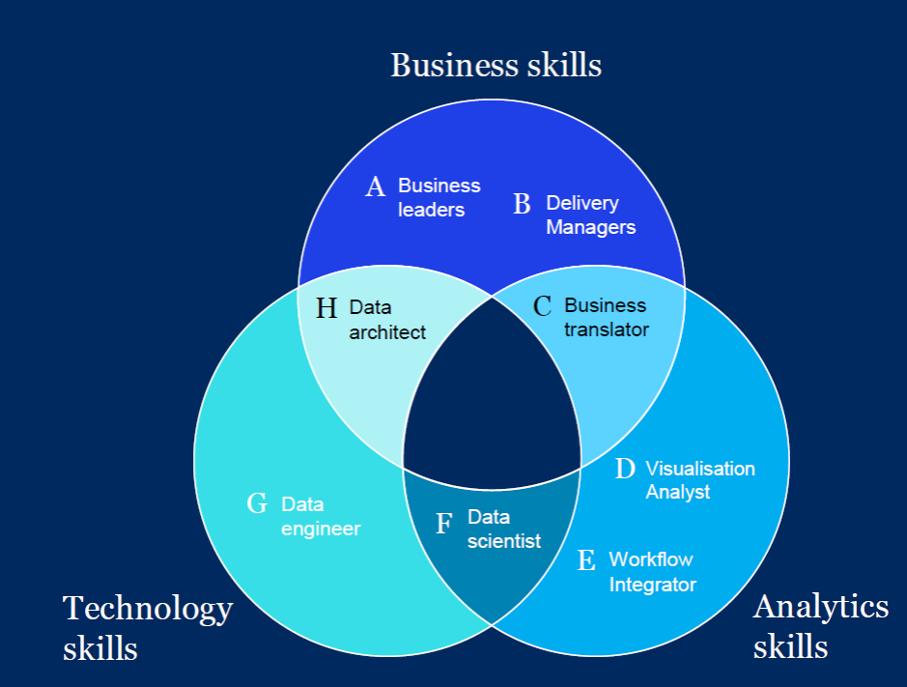
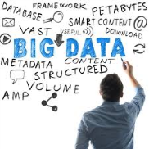
State of the art…
Data scientist (McKinsey Model) vs Actuary with data scientist skills ?

Slide 6
Applications…
Intelligence Artificielle
Machine Learning
& Big Data
Blockchain
Internet of Things (IoT)
Distribution
Cross-selling / Up-selling,
Business developement
Channels
Behavioural detection
Usage-based
Risk prevention
Underwriting
&
Pricing
Pricing models
Price elasticity
Segmentation…
Securing flow transactions
Value Chain digitization
Customization of customer relations
Reduction of risk profiles
Claims
&
Policy
Fraud detection
Customer complaints
Churns
Client Experience (UX)
Process automation
Preventive actions
Fraud control
Auto regulation
Risk Capital Management
Capital allocation strategy
Yields (return) prediction
➔ Drones (real-time analysis, video, new datas…),
➔ New payment system (Pay by use, reduced transaction delay…)

Slide 7
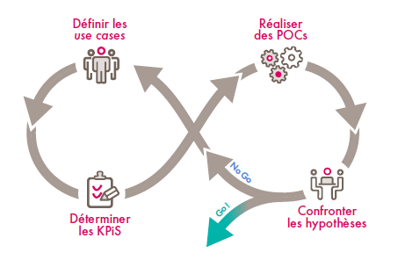
Data’Lab or a 4-step dynamic…
Imagine the business/use case
Be pragmatic : aiming for quick win first!
Define relevants KPIs
Realization of PoC
Materialize
Forming a Squad (multidisciplinary team)
Structuring the project
Choose tools
Collect internal and external data
Define Use cases
Share with experts
Explore
Realize Proof of Concept
Data viz (view the results)
Provide valuable insights
Share with experts
Industrialization of success
Find a sponsor
Accompanying and advising
Communicating more widely
Define relevants KPIs

Slide 8
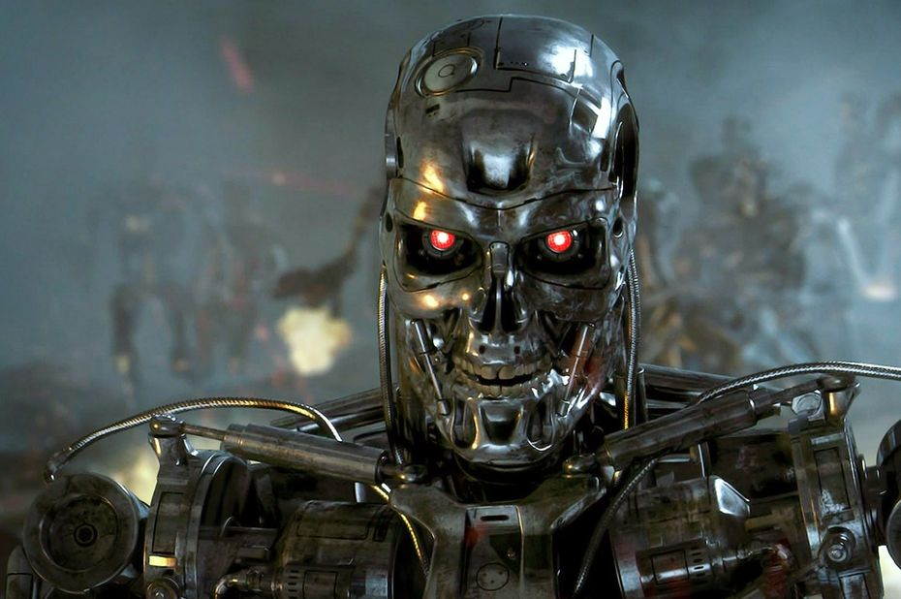
Conclusion and questioning…
Questions ➔ Algorithms ethics?
What about the use of AI in the construction of new military devices?
What threats to the human race?
Will Terminator
(Arnold Schwarzenegger) shift from fiction to reality?
Point of view (2014) ➔ Stephen Hawking, Elon Musk, Bill Gates, ...
Dangers associated with the development of advanced forms of AI, potentially more important than nuclear weapons and a threat to the human race!

