Slide 1
Institut des Actuaires
1st February 2017
SCOR embraces blockchain technology
Régis DELAYAT
Senior Digital Advisor to the Chairman

Slide 2
Agenda
Blockchain: what is it and what is at stake ?
Opportunities and challenges for the (re)insurance industry
SCOR Blockchain “Proof-of-Concept”
What’s next ?
1
2
3
4

Slide 3
Blockchain: what is it and what is at stake?

Slide 4
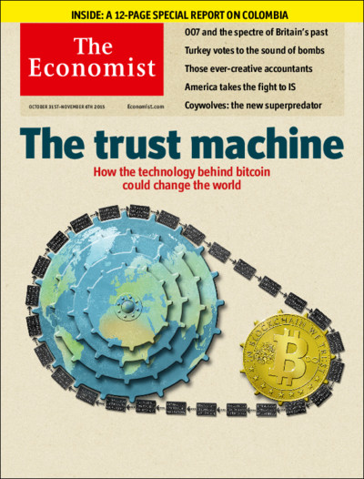
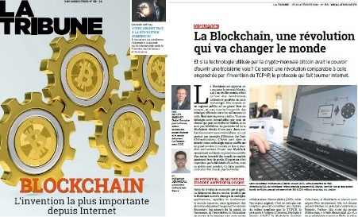
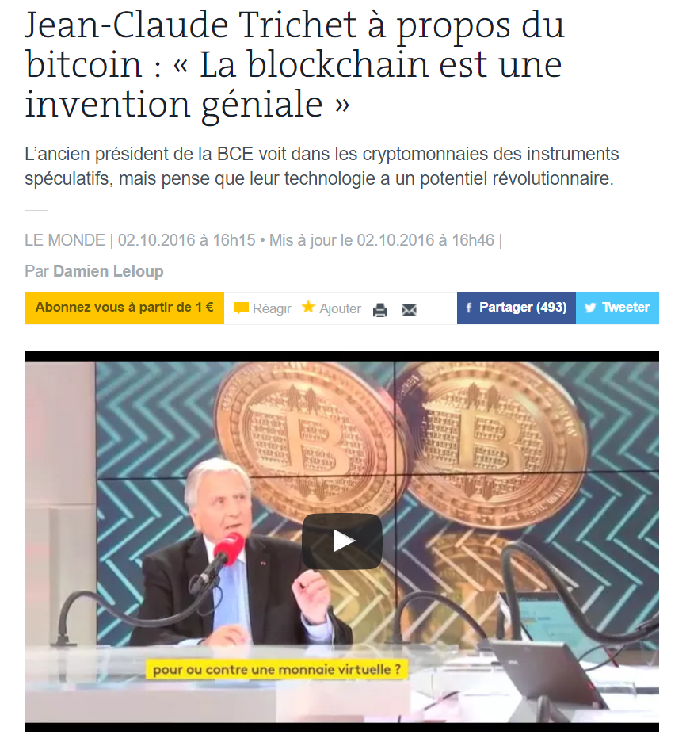
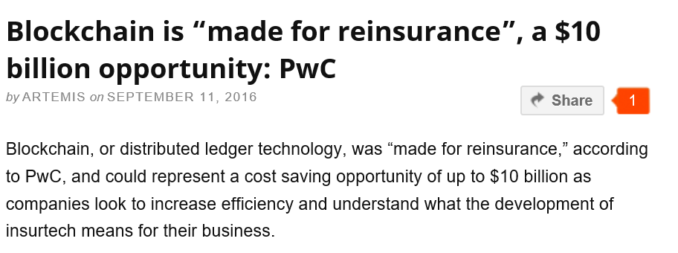
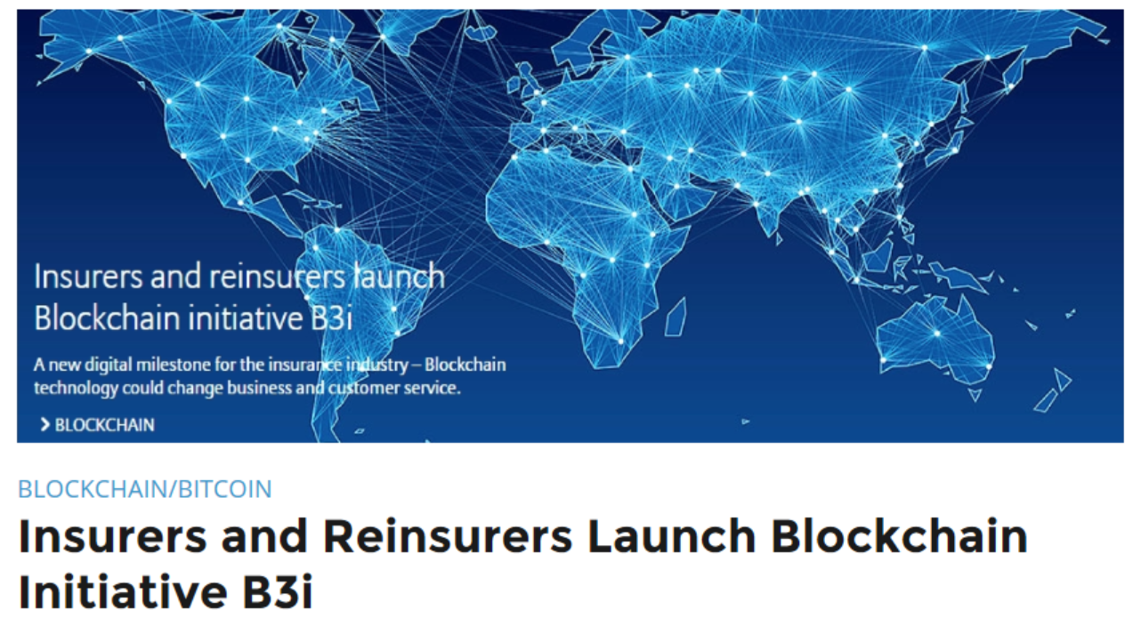
Blockchain: the 2016 buzz?
La Tribune, Feb. 2016
“Blockchain is a revolution that will change the world”
ARTEMIS, Sept. 2016 “Blockchain is made for reinsurance, a $10 billion opportunity” for PWC
Le Monde, Oct. 2016 Jean-Claude Trichet says: “Blockchain is a brilliant invention”
The Economist, Oct. 2015
+733% of search on Google between January 2015 and summer 2016
Fintechnews.ch, Oct. 2016
The Royal Gazette, Sept. 2016
Google search evolution
4

Slide 5
Blockchain: natural digital evolution or real disruption?
e-Commerce Economy
Sharing Economy
Distributed Economy
E-Commerce Website
Sharing Economy Platform
Digital supplier of goods and/or services
Intermediation between services providers and customers
Direct peer-to-peer relationships
Online BtoC sales platform
Online platform providing BtoC and CtoC sales / bidding services
Blockchain-based solution to buy and sell goods and services without intermediary
Online BtoC accommodation booking platform
Online CtoC accommodation booking platform
Blockchain-based solution to rent, sell or share accommodations without a third-party
5

Slide 6
Beyond the hype: major stakes related to Blockchain
Blockchain can become the foundation of a robust system of trust, a decentralized platform of intense collaboration and has the potential to fundamentally change all interactions in the (re)insurance industry
Mutual Blockchains are shared across organizations, owned equally by all
Distributed Blockchains are inherently multi-locational data structures and any user has its own copy, thus providing resilience and robustness
Ledger Blockchains are immutable, once a transaction is written it cannot be erased. This means that the ledgers integrity can easily be proven
Blockchain is a “single version of truth”
Business users can be confident that transaction data and status are precisely the same as seen by their counterparty Any changes or updates are automatically propagated to all parties
6

Slide 7
Reminder of important concepts
“Original” Blockchain or “Mutual Distributed Ledger”
The Mutual Distributed Ledger is a ledger replicated on all the nodes (clients) of a peer-to-peer network
Large book: record events, facts, information or transaction
Security: authentic and unalterable data thanks to advanced cryptographic processes
Transparency: available and shared data since their creation by all the members of the network
Resilience: copy of data are distributed and shared by all the nodes of the network
Disintermediation: autonomous way of working in a P2P mode, without central authority
Internet
Ledger
Ledger
Ledger
Ledger
Ledger
7

Slide 8
Reminder of important concepts
“Smart Contract”
A Smart Contract is a computer program that automatically executes the preset terms of a contract when conditions are met
Neither smart nor a contract, it is a code element containing conditions triggering actions to execute
It is an effective way of implementing “straight-through-processing”
Increase speed / time-to-market
Better efficiency of business processes
Certainty that the contract will be executed as agreed
Internet
If / Then program
Ledger
If / Then program
If / Then program
Ledger
Ledger
If / Then program
If / Then program
Ledger
Ledger
8

Slide 9
Reminder of important concepts
“Oracles”
Oracles are powerful data services that allow blockchain to communicate with the external ecosystem
Oracles collect external information (i.e. trusted private/public third-party databases, etc.) to feed a Smart Contract
The joint implementation of Oracles and Smart Contracts allows autonomous verification of the conditions of a contract
“Trusted” external third-party data
If / Then program
Oracle
Ledger
If / Then program
If / Then program
Ledger
Ledger
If / Then program
If / Then program
Ledger
Ledger
9

Slide 10
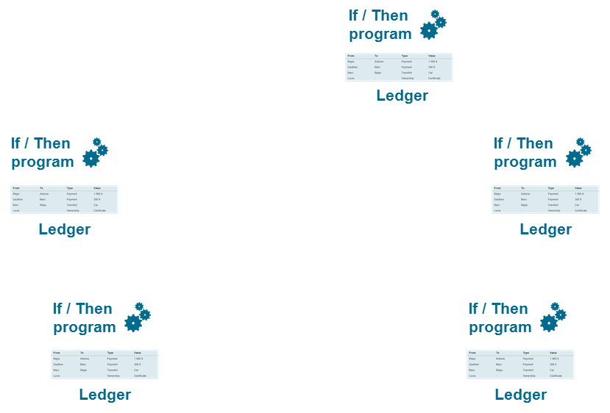
Reminder of important concepts
“DAO” or “Decentralized Autonomous Organization”
A DAO is an advanced computer program that seals in a blockchain the governance that rules an organization
It can be seen as a matrix that articulates a multitude of smart-contracts
Every decision (i.e. action, investment, vote, payment) is achieved in compliance with the rules defined and stored on the blockchain
Internet
10

Slide 11
Technical background on Blockchain
How a transaction does work?
1
2
3
A undertakes a transaction towards B
Transactions are gathered in a block
The block is validated by the nodes with cryptographic techniques
4
5
The block is then added to the chain of blocks (blockchain), to which all the users have access
B receives A’s transaction
11

Slide 12
Introduction to the major Blockchain concepts
12

Slide 13
Why (re)insurers care about blockchain?
Blockchain enables secured peer-to-peer transactions without “trusted central authority”
Peer-to-Peer relationship
Transparency
Security
Disintermediation
The focus shifts from information held by individual entities to information saved in a secured book shared across all verified members of the network
The trust generated by the blockchain process allows to achieve cross-organizational transactions without “trusted central authority”
All verified members of a blockchain network can have an access to the whole set of transactions that occurred since the blockchain creation
Since the blockchain is also immutable, this transparency property makes it easily auditable
The transaction validation process is based on cryptographic methods
The decentralized architecture is a security since every transaction needs to be validated by more than half of the blockchain network
Every slightest modification on the blockchain enhances the modification of all the following elements (blocks) of the blockchain, thus making it instantly detectable
A blockchain implementation can be disruptive by removing the cost of “trusted central authority” recordkeeper intermediary and thus redefining the traditional boarders of organizations and markets
13

Slide 14
Opportunities and challenges for the (re)insurance industry

Slide 15
3 major models can be applied for the (re)insurance industry
Internal Processes
Inter-Organizations
Disruption
1
2
3
Enhance efficiency of core (re)insurance business processes
Speed-up market initiative regarding information exchange
Create new near-autonomous self-regulated insurance business model
Increases speed of exchange between business units/divisions, reducing overall operational costs
Enables new capabilities to be added to existing services and business processes
Managing large commercial insurance programs where different organizations assume separate layers of risks (incl. Insured-Insurer-Broker-Reinsurer transactions)
Development of a new disruptive player that leverage affinity group or peer-to-peer social insurance mechanisms to take advantage of Blockchain Smart Contracts and fund their own coverage pool
Traditional model
New model
Distribution / UW
Claims Handling
Administration
Fraud Detection / Risk Prevent°
Insured
Insurer
Reinsurer
Capital Market
Insured
Insurer
Reinsurer
Insured
Insurer
Reinsurer
Information exchange automation
Core business process enhancement
Automated P2P Insurance
Insurance Intermediaries
Reinsurance Brokers
15

Slide 16
Internal Processes I Opportunities & Challenges
1
Opportunities
Challenges
Automated contracts
“Usage-based Insurance” (e.g. telematics, travel, etc.)
“Instant-insurance” / Individualized contracts that reflect actual risk
Claims handling optimization
Intra/inter-group cessions
Net settlement
Fraud detection
Auditability improvement
Operating costs reduction
…
Blockchain adoption beyond PoC’s
Syndication, ability to engage several market stakeholders to use a distributed Blockchain ledgers approach (e.g. insurers, intermediaries and a network of service providers)
Necessity to have clear and unambiguous contract / claim conditions
Leveraging external data feeding (e.g. flight delays, satellite images, weather stations, etc.)
…
16

Slide 17
Internal Processes I Underwriting
1
Illustration #1 - Life insurance contract lifecycle management
Etat Civil
Update
RNIPP
Client side
1
A father underwrites a life-insurance with his insurer, by designating as beneficiaries his wife and two children
3
Names of the insured and beneficiaries are checked on a regular basis with the RNIPP
In parallel, a verification of the civil status data (weddings, births, divorce, etc.) is also carried out
5
Occurrence of a birth (i.e. potential change in the beneficiaries)
7
The sales rep / tied agent contacts the insure to confirm the change of the beneficiaries
9
Occurrence of death of the insured translates into provision of information at “Etat Civil” level
2
A Smart Contract is created in a blockchain including the following information: insure name, names of the beneficiaries, amount of the life-insurance
4
Useful data is made available on the Blockchain by an Oracle on a regular basis
The Smart Contract checks that the “conditions” defined have not been changed
6
The Smart Contract automatically triggers a notification to the sales rep / tied agent who his responsible for the client relationship
8
The Smart Contract is updated with the
change of beneficiaries
10
Possibility to automatically issue a compensation order to the beneficiaries
Blockchain side
17

Slide 18
Internal Processes I Underwriting
1
Illustration #2 - Usage-based travel insurance
Client side
1
An individual underwrites a trip insurance contract with an insurer, for travelling abroad in the course of his professional activity
3
In the taxi to the airport, the insured activates his multi-trip insurance through the mobile application of the insurer
4
Thanks to the GPS of its telephone, the insured is geolocated abroad in the coverage area of ​​the insurance
6
The insured is informed of the terms and services associated with its coverage
7
Return to France
geolocalisation
The insured person validates his return and the end of the use of his coverage
2
Creation of a Smart Contract which includes the relevant information concerning the guarantee "travel abroad“
Only the relevant guarantee is registered in the Blockchain
4
Insurance is activated
Automatic subscription
8
Insurance is disabled
The amount of the premium to be paid is calculated automatically according to the actual use of the insured (number of days abroad)
Blockchain side
18

Slide 19
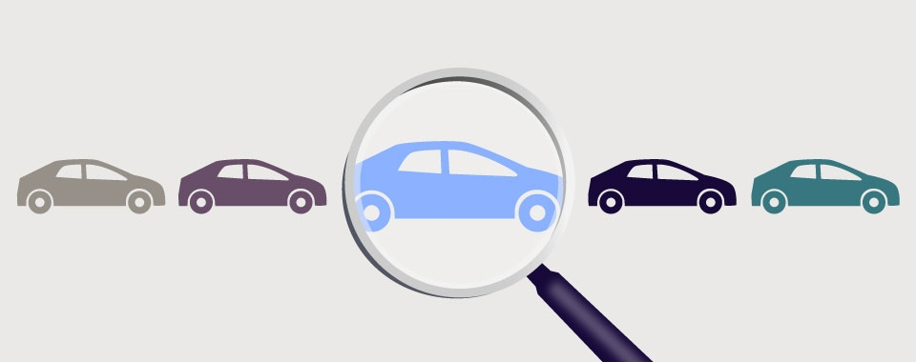
Internal Processes I Underwriting
1
Illustration #3 - Car rental and related car insurance (DocuSign & Visa)
Client side
1
The customer chooses the car he wants to rent after test-driving, evaluating their options, and completing any pre-approvals
3
The customer chooses the lease options for the car – low, mid or high mileage
4
The customer chooses the insurance options - evaluating by coverage, deductible and other factors
6
The customer links his Visa credit card details to pay for the lease and insurance and automatically cover in-car payments (e.g parking…)
7
With the lease and insurance contracts DocuSigned and the Visa credit card integrated, the customer is ready to drive
2
The car identity is then registered on Blockchain
5
A corresponding smart contract is created on the Blockchain
8
Once a customer has been driving the car, the system can start to track activities and potentially deliver savings on insurance, or advice about cheaper leasing option
Blockchain side
19

Slide 20
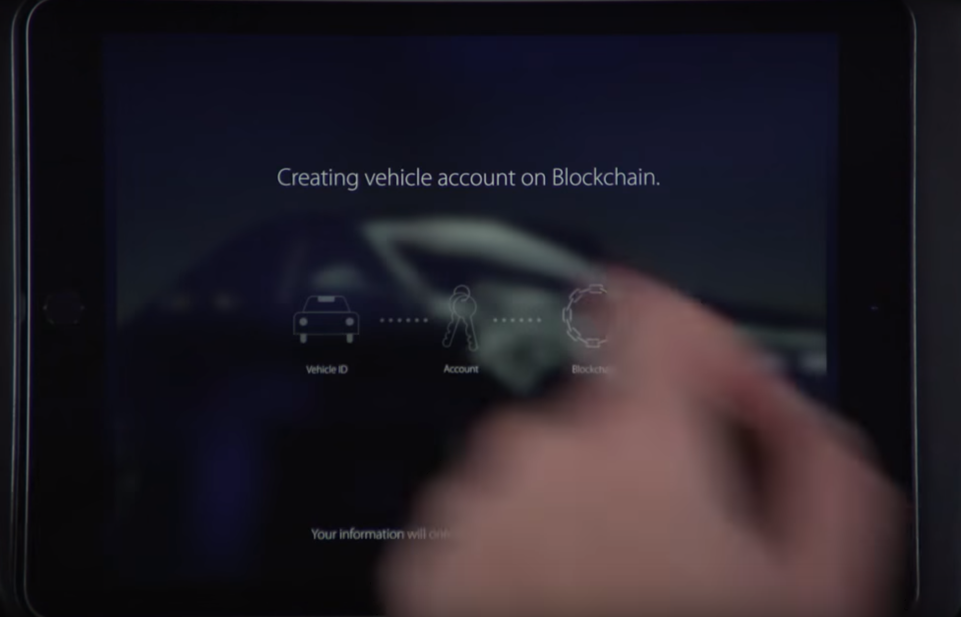
Internal Processes I Underwriting
1
Illustration #3 - Car rental and related car insurance (DocuSign & Visa)
20

Slide 21
Internal Processes I Claims Handling
1
Illustration #1 - Weather index-based farm insurance
15 days
Client side
1
Underwriting of an “business interruption" insurance between a farmer and an insurer
3
The rainfall data is measured by an external service (Ex: Pleinchamp.com)
5
Occurrence of a period of 15 consecutive days without rain (i.e. reaching the insurance guarantee threshold)
8
Compensation received by the farmer without declaration of loss and without the intervention of an insurance expert
2
Creation of a Smart Contract in a blockchain including a “drought” guarantee
4
6
7
Rainfall data is made available on the Blockchain by an Oracle on a regular basis
The Smart Contract checks that the "conditions" imposed by the contract are not fulfilled
The Smart Contract automatically triggers compensation for the farmer
Automatic issue of a compensation order to the farmer for the predefined compensation amount
Blockchain side
21

Slide 22
Internal Processes I Claims Handling
1
Illustration #2 - Flight insurance delay compensation (InsurETH)
Client side
1
An individual underwrites an automated flight insurance to protect him from flight delay
3
A flight delay occurs, the delay data is measured by an external service (Ex: WebService Amadeus)
6
The subscriber is automatically notified of the payment
2
A contract with specific policy conditions is built and added in the public ledger of the Blockchain. The individual remains anonymous
4
The event (e.g. flight delay) is notified to the Blockchain Oracle The contract gets triggered by the Oracle and the contractual conditions are checked If the conditions are validated, the pay out is automatically made to the subscriber
5
The smart contract is updated with the relevant claims handling information
Blockchain side
22

Slide 23
Internal Processes I Fraud & Risk Prevention
1
Illustration #1 - Diamond certification (EverLedger)
Client side
1
An individual acquires a diamond An official authentication certificate is generated and provided to the buyer
3
After a period of time, the diamond owner declares the theft of his diamond to his insurer
5
Some months later, the diamond reappears on the market on a major market place (e.g. professional marketplaces, etc.)
7
The marketplace checks the Blockchain and detects the theft of the diamond some months before
2
The official diamond certificate (including all diamond specificities) is uploaded within a Blockchain public ledger
4
The event is registered within the Blockchain and the diamond certificate is updated with this information
6
Blockchain allows insurer or potential purchasers to check the history of any individual stone, including previous claims, helping insurers prevent, detect and counter fraud
Blockchain side
23

Slide 24
SCOR Blockchain “Proof-of-Concept”

Slide 25
Inter-Organizations I Overview of the “Ruschlikon” initiative
2
Ruschlikon is a large global community of insurers, brokers and reinsurers reshaping the (re)insurance industry through the design and implementation of standard dematerialized exchanges and processes, reducing operational cost and enhancing client service
FROM “Traditional process and its limits”…
… TO “Time and cost saving” with
Still largely paper-based, or email attachment
A significant part of today’s (re)insurance premium is wasted with the unproductive frictional costs of administrative processes between insurers, brokers, reinsurers and retrocessionnaires
Identify, design and implement industry-wide standard formats, processes and electronic exchanges
Reduce cost of interactions within the ecosystem
Improve data granularity and quality for all, using ACORD data standards and Ruschlikon business processes
Ruschlikon connects leading players of the (re)insurance industry to advanced back office processes such as technical accounting, claims and settlement
25

Slide 26
Inter-Organizations I Overview of the “Ruschlikon” initiative
2
Process Automation
Less re-work & Queries
Enhanced Cashflow
Improved Controls
Increased Efficiency
Ruschlikon value proposition
The Ruschlikon Initiative connects leading players of the (re)insurance industry to advanced back office processes including technical accounting, claims and settlement using the ACORD Global Reinsurance and Large Commercial (GRLC) Standards
6
Continents
Implementation Group
Consistent approach, using global standards, driving worldwide coverage
40
Countries
Steering
Group
Brokers and (Re)Insurers
Marketing
Group
100’s of Companies
Technology Providers
1000’s of offices
Regional Communities
Standard Data Messages
Placement
Accounting
Settlement
Placing Platform
Placement Messages
TA (closing advice)
FA (financial statement)
CM (claim movement)
ACK (message acknowledgement)
PSR Message (settlement files)
26
Reconciliation Messages
26

Slide 27
Inter-Organizations I Overview of the “Ruschlikon” initiative
2
Ruschlikon members
Ruschlikon implementations update: 77 partnerships / 46 companies covering commercial insurance, coinsurance and reinsurance across 6 continents / in more than 40 countries
Market share
Ruschlikon reinsurers represent more than 60% of the global reinsurance market
The 3 leading brokers are Ruschlikon members, and represent 75% of the reinsurance broker market
The Ruschlikon carriers cover around 50% of the P&C business written in the London Market
27

Slide 28
Inter-Organizations I Overview of the “Ruschlikon” initiative
2
Ruschlikon e-workflow
Insurance
Reinsurance
1
Insurance underwriting, direct or via a broker
2
Insurance broker placement
3
Co-insurance placement
Insurer
4
Internal reinsurance
5
Reinsurance via broker
Co-Insurer
6
6
Direct reinsurance
7
Reinsurance broker placement
8
Retrocession via broker or not
2
Reinsurance
Broker
7
3
5
Reinsurer
1
Insurance
Broker
2
Insured
5
4
Insurance
(Internal Reinsurer)
6
1
Insurer or
Lead
Co-Insurer
8
Reinsurance
Broker
8
8
Reinsurer
(Retrocessionaire)
28

Slide 29
Inter-Organizations I Overview of the “Ruschlikon” initiative
2
Demonstration video: “The (re)insurance end-to-end process in the digital world”
29

Slide 30
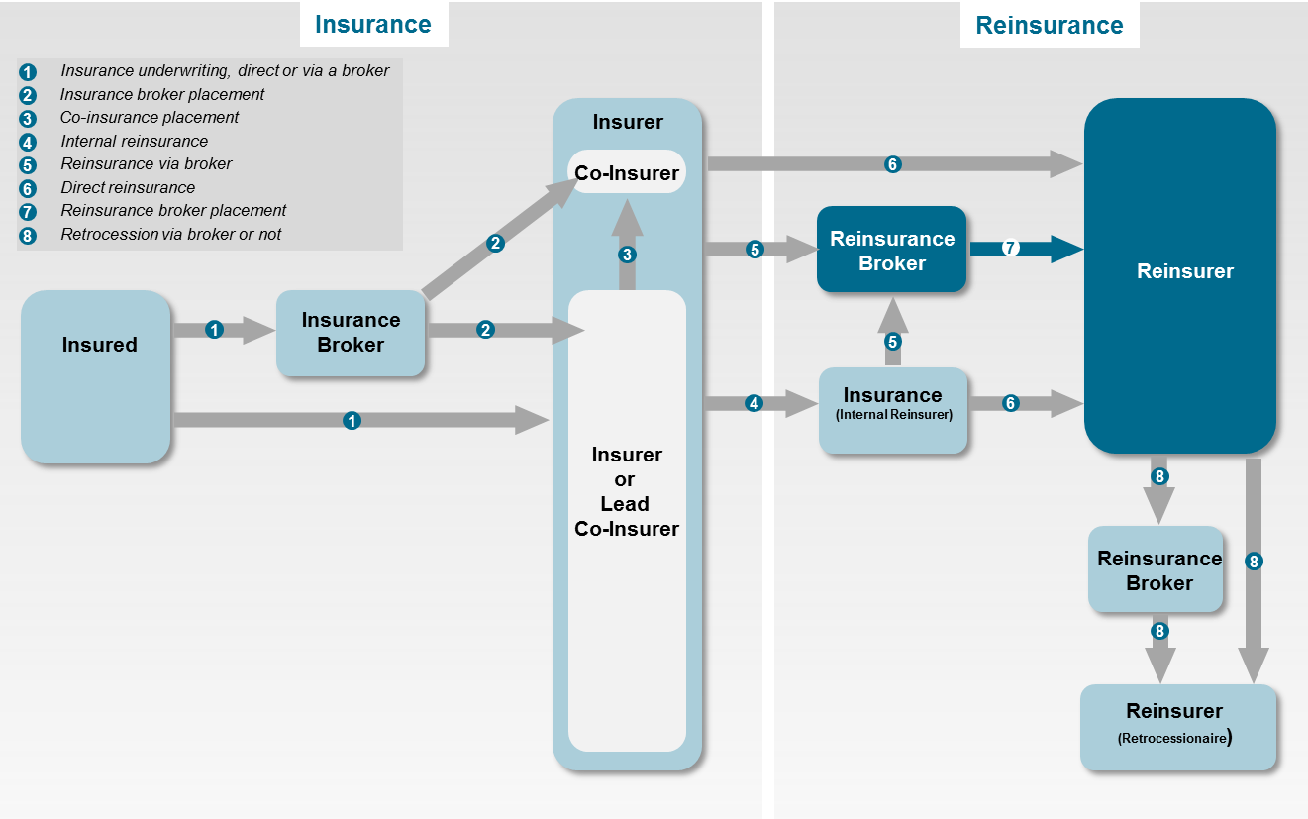
Inter-Organizations I SCOR Blockchain “Proof-of-Concept”
2
Business scope of the SCOR Blockchain PoC (on behalf of Ruschlikon)
SCOR has performed a 2-month “Proof-of-Concept” to assess the feasibility of using blockchain technology (permissioned Ethereum) to enhance the Ruschlikon initiative
A simulation of representative core transactional data exchange (ACORD “Technical Account” and “Acknowledgement” messages) between 2 Reinsurance Brokers and 1 Reinsurer has been successfully implemented
30

Slide 31
Inter-Organizations I SCOR Blockchain “Proof-of-Concept”
2
Key stages of the end-to-end business process
Reinsurance Broker #1
Reinsurer reviews the TA-data in detail and checks for completeness and accuracy by comparing with respective SCOR reinsurance back-office system information
Reinsurer #1
Broker #1 enters TA-data into its own back-end system (manually or via XML file)
This includes partner- and contract-information, premium amounts etc., and can include supporting documents
1
4
A cockpit provides secure and immediate view to all partners involved in the respective transaction, in addition to general partner information
Broker #1 submits the TA-data and the supporting documents into the Blockchain
Reinsurer is notified, and retrieves the submitted data
Reinsurer agrees the TA-data, or a query is notified to the broker in case of disagreement
6
2
3
5
Consortium Blockchain
“Chinese wall” / Complete data confidentiality
Reinsurance Broker #2
31

Slide 32
Inter-Organizations I SCOR Blockchain “Proof-of-Concept”
2
Demonstration of the solution
32

Slide 33
Inter-Organizations I SCOR Blockchain “Proof-of-Concept”
2
Overview of supporting technologies
Secure connection
Cloud Environment
Cloud Environment
Application stack
Storage
Application stack
Storage
Secured connection
Reinsurance Broker #1
Reinsurer #1
Consortium Blockchain
Consortium Blockchain
Reinsurance Broker #1 node
Reinsurer #1 node
Secured connection
Secured connection
Secure Private Network
Internet
Secured
connection
Secured connection
Cloud Environment
Cloud Environment
Secure connection
Application stack
Storage
Application stack
Storage
Miner(s) validate and commit transactions in order to reach consensus (i.e. a review process performed on each block within the Consortium Blockchain)
Reinsurance Broker #2
Consortium Blockchain
Consortium Blockchain
Reinsurance Broker #2 node
Validation node (Blockchain Miner)
33

Slide 34
Inter-Organizations I SCOR Blockchain “Proof-of-Concept”
2
Data privacy and segregation
Smart Contract
Smart Contract holds no sensitive data
Sensitive Business Data
All data and documents are digitally sealed and timestamped on the Consortium Blockchain for reference
Encryption key only shared between transacting parties (not stored on Blockchain)
Broker Blockchain Acct ID
Reinsurer Blockchain Acct ID
UUID (i.e. Unique User ID)
State (i.e. TA Message Status)
Encrypted
TA data pointer
Reference
Risk Digital Data (e.g. TA data fields)
Location
Digital Seal
Document pointer
Encrypted
Reference
Supporting Documents
(e.g. TA supporting docs)
Location
Digital Seal
Stored on Consortium Blockchain
Stored locally and on shared storage between relevant counterparts (never on Blockchain)
34

Slide 35
Detailed view of the SCOR’s TA Blockchain “Proof-of-Concept” solution
Node components
Scope of the existing “Proof-of-Concept”
Out of existing scope
Peer 2 Peer network – Provides the connectivity between nodes (Ethereum DEVP2P)
Blockchain Client – Transaction submission, transaction storage, Blockchain accounts and chain interface (Ethereum)
Smart Contracts – Written in solidity then complied for EVM, accessed through Blockchain client (Ethereum)
Whisper – Dark, secure and guaranteed transient notification routing (Ethereum)
Secure Shared Storage Access – Stores encrypted data which is referenced in smart contracts, also Consortium (AWS S3)
Private Local Storage – Stores local copy of encrypted data for guaranteed access. Holds symmetric encryption keys and Blockchain account keys (MongoDB + File system)
Decentralised Application – JavaScript based application with added access control for underlying components. Acts as the glue between all components (Meteor Server)
Graphical User Interface – Web based end user interface to TA PoC application (Meteor Client)
Graphical User Interface
Application interface
Decentralised Application
Blockchain
Client
Smart Contracts (EVM)
Whisper
Secure Shared Storage Access
Private Local Storage
Peer 2 Peer network
Source: SCOR TA Blockchain POC Working Group – Oct. 2016
35

Slide 36
Inter-Organizations I SCOR Blockchain “Proof-of-Concept”
2
Team and Organization
SCOR team (28 mandays)
Blockchain start-up team (74 mandays)
Business Owner
Sponsor
1,5 MD
SGP&C COO (Paris)
1,5 MD
SCOR Group CIO (Paris)
12 MD Insurance and Digital Specialist (Paris)
Project Managers
Solution Architect
Blockchain Architect
16 MD
Insurance Specialist
15 MD
Product Lead (London)
Business Analysts
IT Lead
Delivery Manager
6 MD
Ruschlikon Business Experts (London, Zürich)
1,5 MD
Ruschlikon IT Lead (Paris)
4 MD
Blockchain Expert (London)
IT Analysts / SME
Lead Software Developer
6,5 MD
Ruschlikon IT analyst Charlotte, NY, Toronto)
20 MD
Lead Software Dev. (India)
Software Developers
19 MD
Software Developer / tester (India)
36

Slide 37
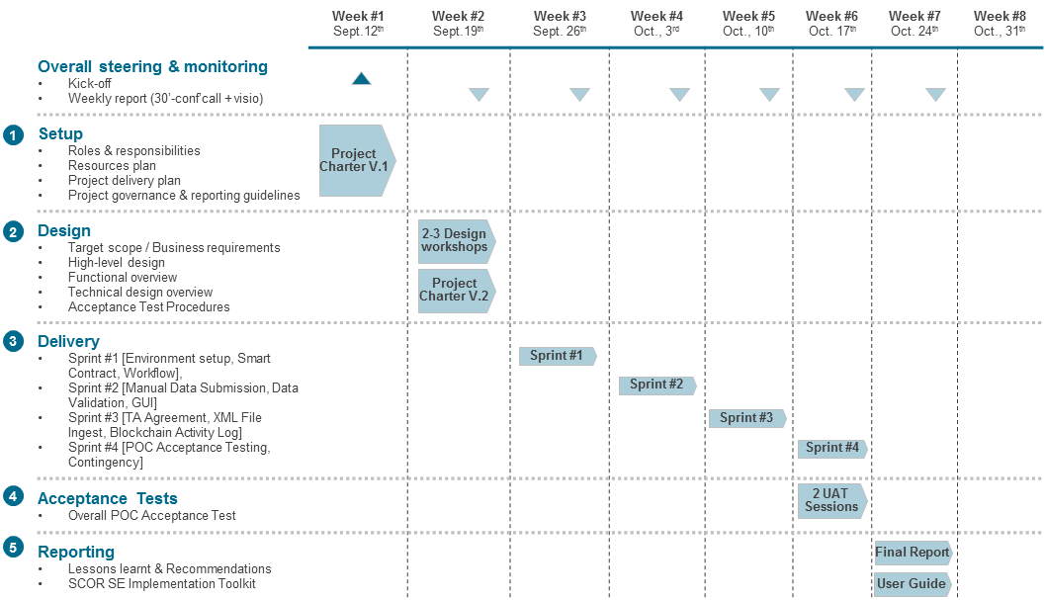
Inter-Organizations I SCOR Blockchain “Proof-of-Concept”
2
8-weeks delivery plan
37

Slide 38
Inter-Organizations I SCOR Blockchain “Proof-of-Concept”
2
Major outcomes
The PoC proved that blockchain could successfully deliver this trading capability, it also showed that there are wider opportunities and future considerations
Positive Results
To be checked
?
Agile and quick development over a 2-month period
Confirming technical feasibility and efficiency potential
Close to real-time message-hub
Robust, secure, encrypted, permission driven environment
Immutable, traceable, auditable
Forces unique, simplified way of interaction
Single version of truth
No message resubmission and no duplicate messages
Relevant supporting documents securely shared
Efficiency gains and cost reductions
Onboarding costs: Easiest way to integrate new partners
Running costs: unique, simplified way of interaction, cheap infrastructure costs and simplified “release management” between counter-parts
Scalability, performance, privacy
Behaviour in multi-company, high-volume, complex business environment not yet experienced
Shift to community
Scope, active participants, target-operator, technical environment, multiplicity of the Blockchain communities
Coexistence with existing world, building the “new”
Necessity to maintain “old” and “new” world in parallel
Further study integration with our systems
Need to partially re-architecture/rebuild e-processing/Omega back-end environment
Total cost perspective
Apparently inexpensive technical setup – but total cost of developing and running a fully integrated Blockchain still to be explored
38

Slide 39
What’s next ?

Slide 40
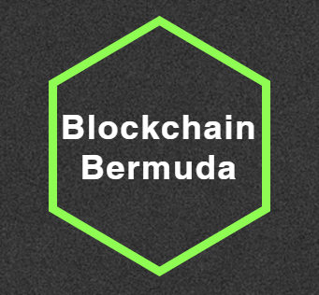
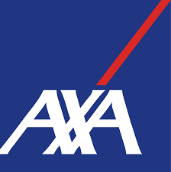
The (re)insurance ecosystem has already begun to address the topic
Market initiatives
Oct. 2016 – Launch of B3I “Blockchain Insurance Industry Initiative”
Dec. 2015 – Blockchain innovation lab with AXA Group, BNP Paribas, BPCE Group, CNAM, CNP Assurances, Crédit Agricole Group, Croissance Plus, French Finance competitiveness pole and several Blockchain start-ups
March 2016 - In the frame of the new TOM, opportunity study on how Blockchain technology can automate exchanges between Ceding companies / B2B Brokers and Reinsurers
May 2016 – Launch of Blockchain Bermuda non-profit cross-industry think tank Focus on Insurance Linked Securities (ILS) market to trade more liquidly and expand beyond the P&C sector
Oct. 2016 – Launch of the InsurTech Academy, a collaborative research consortium for insurers to explore areas of common interest in Blockchain
Oct. 2016 – Launch of the FFA Insurance Blockchain consortium in the frame of the Digital Commission
Jan. 2016
Today
Individual
(re)insurers
initiatives
Jan. 2016 – Several Proof-of-Concepts performed at Group level on Blockchain on core insurance processes
March 2016 – Blockchain Proof-of-Concept launched at Allianz France level on intra-organization business processes
May 2016 – Blockchain PoC for intra-group retrocession process
June 2016 – Blockchain PoC at Group level dedicated to Cat Bond management
August 2016 – Member of the R3 CEV Blockchain consortium
Sept 2016 – Launch of a Technical Accounting Blockchain PoC based on Ruschlikon TA / ACK ACORD message exchange
May 2016 – Chinese bankinsurer that joins R3 CEV Blockchain consortium
June 2016 –Member of the R3 CEV Blockchain consortium
40

Slide 41
B3I, one truly significant (re)insurance market initiative
Launched in October 2016, B3I (i.e. “Blockchain Insurance Industry Initiative”) is aiming to explore the potential of blockchain to better serve clients through faster, more efficient and secured services
…+ new joiners
The 5 founders of B3I (Aegon, Allianz, Munich Re, Swiss Re and Zurich) and new members are actively working on inter-group retrocession in order to move forward on this topic and assess how Blockchain technology can be established as a viable tool for the (re)insurance industry
41

Slide 42
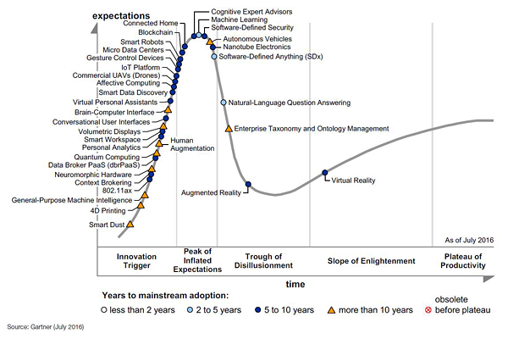
… nevertheless, it remains a nascent technology
Gartner’s 2016 hype cycle for emerging technologies
Estimated capital investments spending on Blockchain technology ($M)
+~60%
Source: Gartner, July 2016
Source: Alte Group, December 2016
A technology which is at the top of the “hype” phenomena with a mainstream adoption estimated at 5-10 years
A strong increase of investment planned for 2017
42

Slide 43
What Blockchain adoption could look like?
Maturity
Blockchain adoption is considered mainstream
Today
Growth
The network effect takes hold: (Re)insurers begin to see the benefits experienced by early-adopters and combined with regulatory guidance and certainty
New products / services are created
Deployments go viral across numerous use cases
Early Adoption
Leading (re)insurers see the value
1st community roll-out for inter-group retrocession are performed
Rule-making begins: Regulatory authorities realize the benefits for auditing and compliance
Exploration & Development
Initial capability and use-case assessments
Individual PoC’s
2020 and above
2018 - 2020
2016
2017
43

Slide 44
Combination of IoT, Blockchain and AI could enable sustainable development at scale
Maxim Orlovsky: ‘’l’avenir appartient à ceux qui sauront faire converger les technologies de l’intelligence artificielle et le système de la blockchain’’.
Neuroscientist, cognitive architectures specialist with experience in neural networking, machine learning, pattern recognition, data science and compexity science. PhD, MD.
While IoT and AI will enable the ‘animation of the physical world Blockchain’s smart contracts on the immutable distributed ledger will allow real economy assets, infrastructures and processes to interact with the financial system in predictable ways and with business models that were unheard of ten years ago.
“Providing this two-way real-time interoperability between the real economy and the financial system will be disruptive”
Source: http://www.econotimes.com/Combination-of-IoT-blockchain-and-AI-would-enable-sustainable-development-agenda-at-scale-UNEP-469385

Slide 45
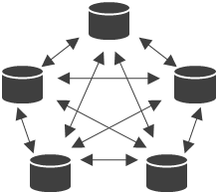
A preliminary vision of the potentialities: mixing Blockchain and AI
[Short-term – 3 years]
[Mid-term – 10 to 15 years]
[Long-term – 30 years]
Combination of IoT, Blockchain and AI
Blockchain, a guarantee to control AI
Blockchain, a new architecture for a new AI
IoT
AI
New AI
AI
AI
AI
Blockchain
Blockchain
Blockchain
AI
AI
Providing this two-way real-time interoperability between the real economy and the financial system will be disruptive
The Blockchain consensus might be a way to keep potential malicious AIs under control
The Blockchain technology might open the way to a new type of AI by getting closer to the real neuronal behaviour
From « Proof-of-Work » to « Proof-of-Recognition »
BICA Labs
45
Notes:
1) IBM Watson + IoT
IBM Watson IoT Platform enables IoT devices to send data to private Blockchain ledgers for inclusion in shared transactions with tamper-resistant records. Blockchain’s distributed replication allows your business partners to access and supply IoT data without the need for central control and management.
All business partners can verify each transaction, preventing disputes and ensuring each partner is held accountable for their individual roles in the overall transaction.
Sources: http://www.ibm.com/internet-of-things/iot-news/announcements/private-blockchain/
2) Blockchain might help ensuring friendly AI
Reputation: Agents, human and otherwise, operating on networks in the future could likely similarly care about their reputation and take measures to maintain it.
Consensus Models: Known malicious players would be unable to execute their transactions, and thus only friendly players (human or AI) would be able to conduct a survivable level of transactions.
Resource: Blockchain AI must obtain physical-world resources, if the AI is not friendly, its ability to obtain resources may be limited and expensive, and thus Friendly AI is produced.
Source: https://cointelegraph.com/news/blockchain-ai-5-top-reasons-the-blockchain-will-deliver-friendly-ai
3) BICA Labs
BICA Labs is a non-profit research team focused on applied aspects of artificial intelligence and underlying technologies. We develop specialized machine learning solutions employing convolutional neural networks and other biologically-inspired approaches for building cognitive architectures. Our solutions are suited for analysing big data, collected from sensor networks, IoT, decentralized databases, including blockchain-based.
Sources : http://www.slideshare.net/bicalabs

Slide 46
Key ideas to remember
Blockchain can become the foundation of a robust system of trust and has the potential to fundamentally change all interactions in the (re)insurance industry
Structuration and early tests have significantly progress over the last months
1st concrete Blockchain applications will be rolled-out in production by end of 2017
Significant benefits will only emerge if the whole (re)insurance community adheres to marketplace blockchain initiative(s), but…adoption promises to be quick
46

